Slide 1
Software Engineering
Final Project Wrap-Up
Our Team:
Luke Prescott (lead)
Sean Loucks
Jack Holden
Max Moore
Chin Wa Cheung
Will Dahl
Gary Passarelli
Notes:
Jack

Slide 2
A Statement of the Project
Notes:
Jack

Slide 3
The final project completed was a thin-client application.
More specifically, it is a secure online testing tool that’s function is the managing, administration, and taking of multiple-choice and true-false examinations.
Let’s look at the user and administrative components.

Slide 4
The User Component
One can take any number of assigned tests, receiving said results, as well as viewing results of previously taken tests. Users can also:
Update their account login information.

Slide 5
The Administrative Component
The testing system also includes an administrative component where one can create, read, update and delete all types of users, questions (answers), and tests – as well as view user’s results. Admins can also:
Invite users to take a test.
Mark users as inactive, restricting them from logging in.
Create tests by uploading a .csv file which the project converts to a functional test.

Slide 6
The Design We Used
Notes:
Chin Wa Cheung

Slide 7
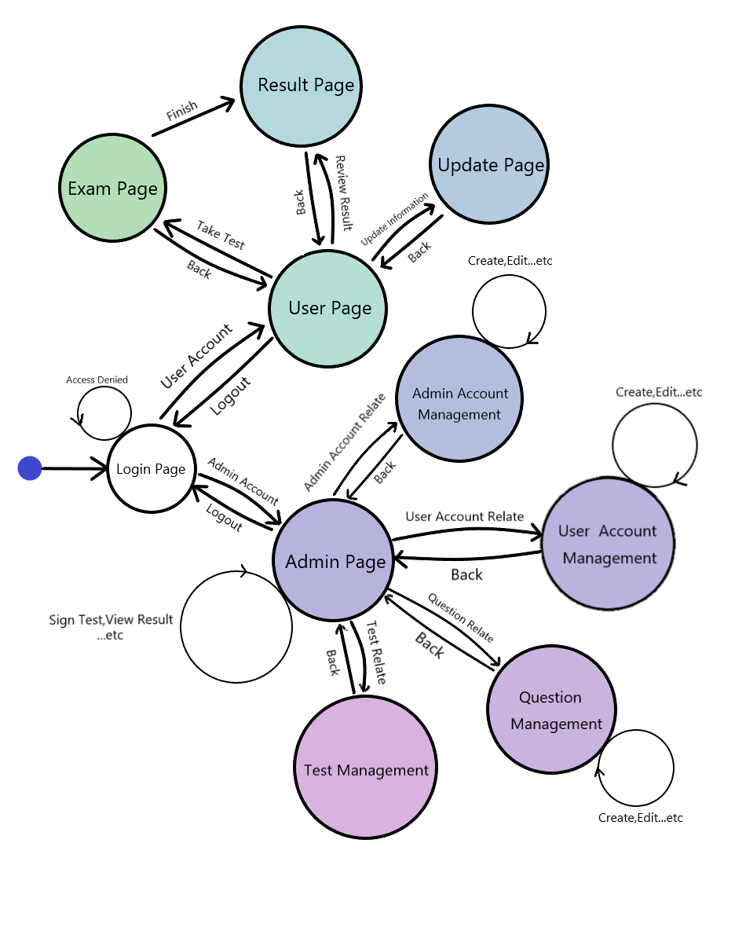
For High-Level Design...
Concise Structure
User Friendly Design
High Efficiency
Easy to Modify and Maintain
Also Helps a lot on source file organization
Notes:
Chin

Slide 8
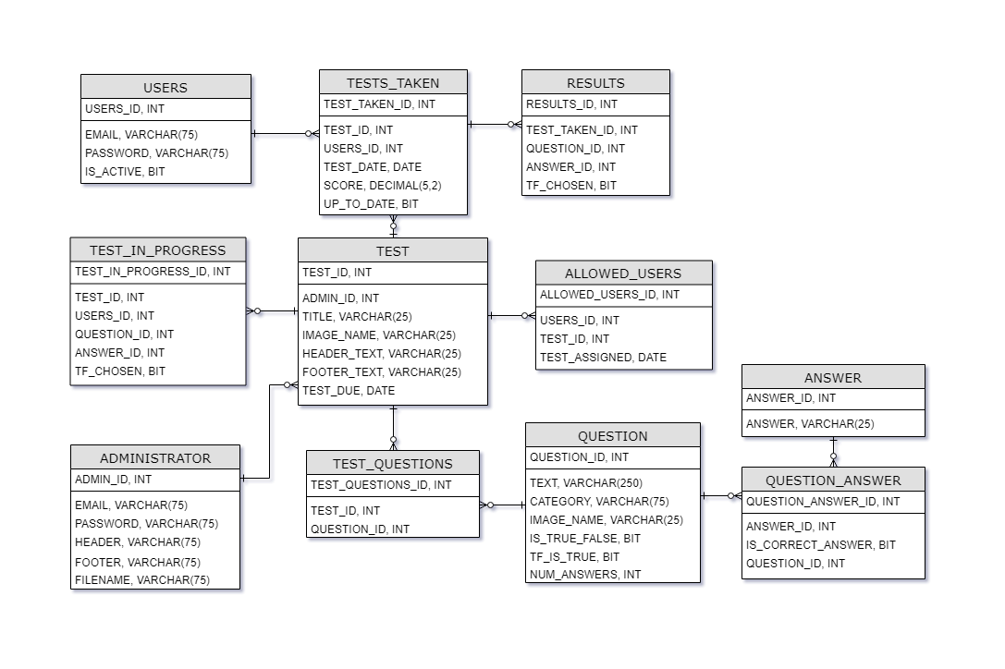
The
D.B.
We
Started
With
Notes:
Chin

Slide 9
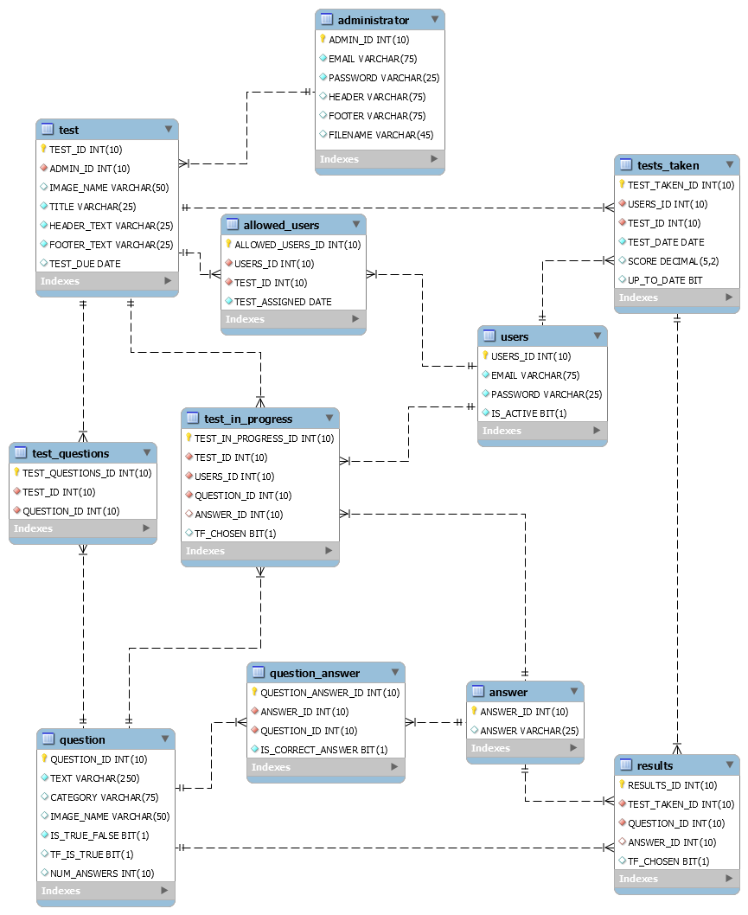
The D.B. We Culminated To
Greater Interconnectivity
Quantity of entities & attributes
The first entity-relationship diagram was done in the open toolset: draw.io.
This diagram was done through MySQL Workbench’s reverse engineering feature.
Larger image here.
Notes:
Chin

Slide 10
Our Technology Stack

Slide 11
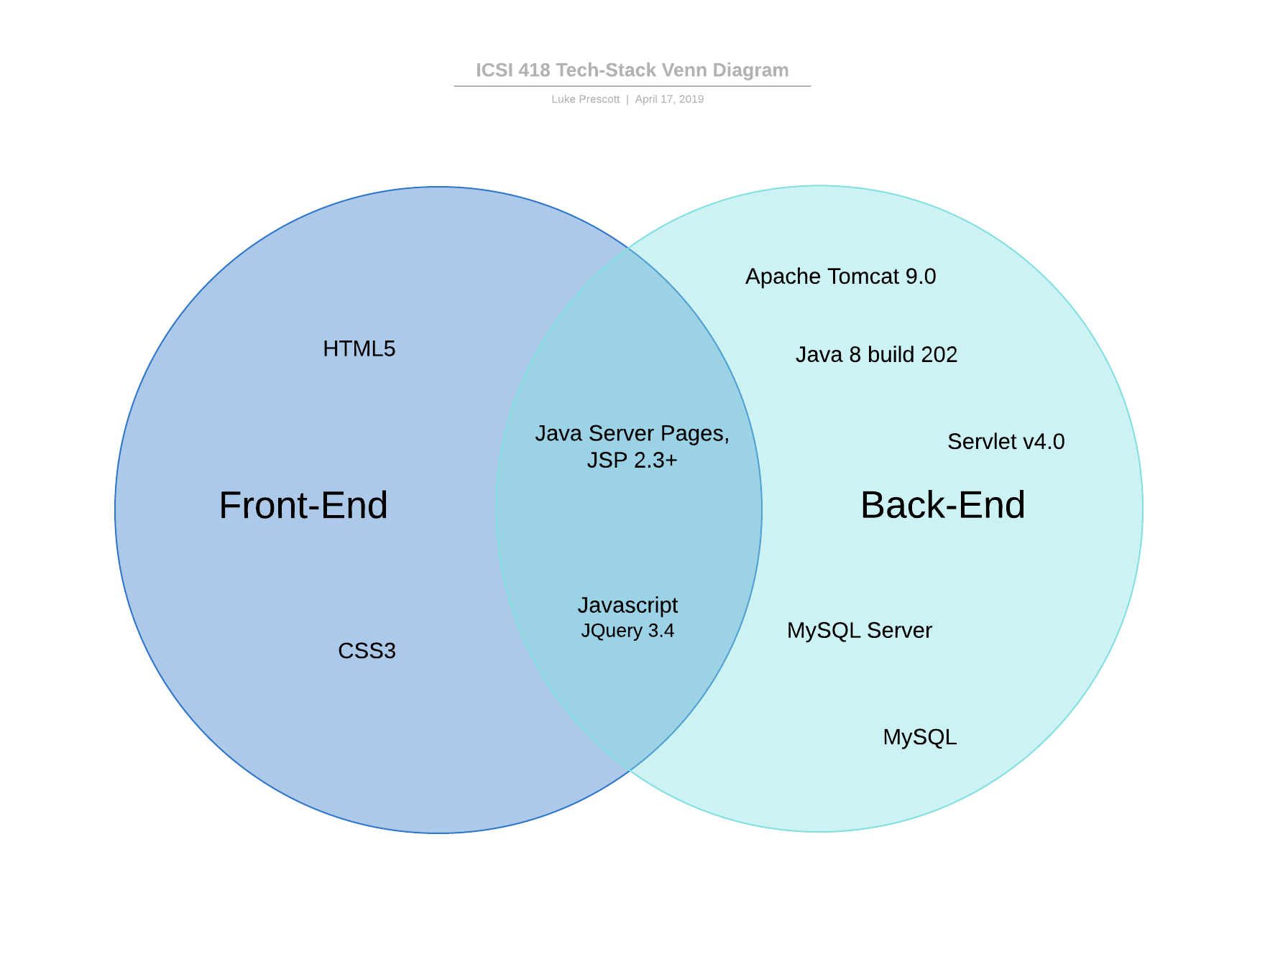
Dependencies
javax.servlet-api 4.0.1
javax.servlet.jsp-api 2.3.3
jstl 1.2
mysql-connector-java 8.0.15
javax.mail 1.6.2
commons-io 1.3.2
commons-fileupload 1.4
opencsv 4.5
A Two-Set Venn Diagram done in LucidCharts
Notes:
Luke

Slide 12
Our Sprint Plans

Slide 13
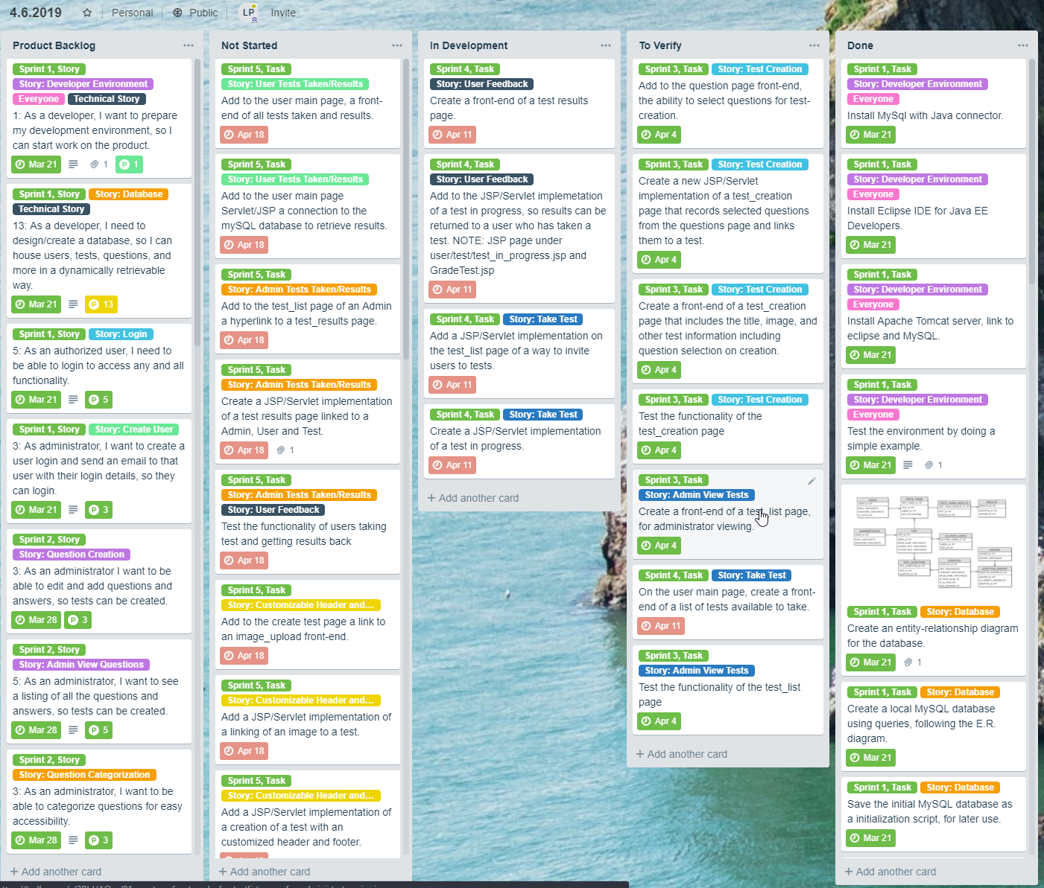
Trello Boards
We used an ‘agile-column’ technique with multiple Trello Board add-ons:
Agile-Tools
Charts by Vizydrop
Print-Cards
Note the use of tags, story points, and due dates.
Not shown here: member sign-up.
The board to the right is a screenshot of a
backup from 4/6/2019 when we were, “in the thick of it.”
Live board here.
Notes:
Luke

Slide 14
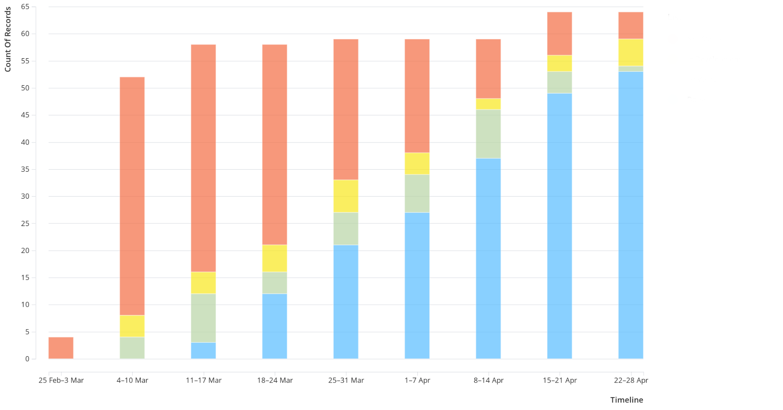
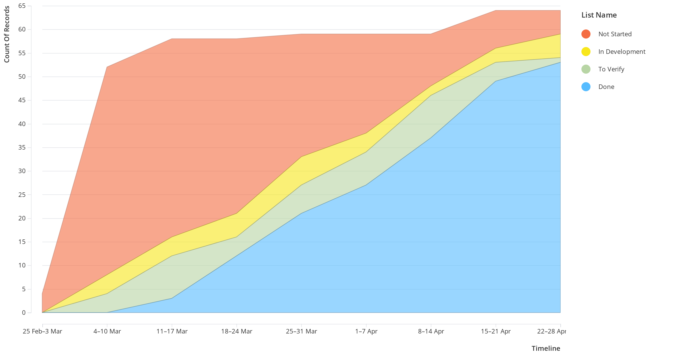
VizyDrop Charts
A free addon to Trello Boards.
This chart preset was called cumulative flow:
However, we know this as a ‘sprint burn-up’.
Just under 65 total tasks.
Currently, we have less than 10 to go, with 10 currently in progress.
These final tasks are deployment and documentation related.
Interactive VizyDrop chart here.
Notes:
Luke

Slide 15
What Went Well
Notes:
Will
Planing
Use of github
Use of terllo
Work load was evenly spaced out
Early start
Steady burn down
Using the same development environment
Ordering our tasks based on dependencies.
Testing each task as we went
Meeting With product owner every week to update on what has ben done so far and get input on product
Tracking of our tasks.

Slide 16
Planning
Everything had been planned before starting development.
Design of backend was finalized before development began.
This allowed us to ensure work was evenly spaced out through the sprints.
Gave all the members a clear idea of how the system was to work.
An overall increase in efficiency.

Slide 17
Our Sprint Plan
Workload among the sprints was evenly spread out.
Burn down was steady and linear over time.
No rushing to finish tasks at the end.
Tasks were ordered by dependencies.
Worked testing in to every sprint.

Slide 18
Tools Used
Everyone used the same development environment.
Use of eclipse made building the project easier and more streamlined.
Use of GitHub for version control allowed easy access among members.
Using Trello for our sprint plan made monitoring what was done, what needed to be tested, what was in development, when tasks were to be done by easily viewable by everyone in the group.
Being able to track our progress.

Slide 19
Meeting with Client
We met every week with the product owner.
Allowed us to verify our current progress.
Kept us away from project drift and on task.
Asked more in depth and specific questions regarding use and user experience.
Asked specific questions on future requirements that still needed to be implemented before development began.

Slide 20
Lessons Learned
Notes:
Max Moore
- A lot, many of us were working with a software stack for the first time and using certain languages for the first time. JSP, AWS, SQL
-Multiple team members volunteered for the same task. Necessary for some tasks but not for others
-Very hard to story point a project in which we have no experience with. Underestimated the amount of work for the first sprints
-We should have met more times than twice a week. It would have helped with accountability and productivity.

Slide 21
New Experiences
-Most team members have never developed in a software stack.
-Learning new languages along the way.
-Very hard to story point a project we have no experience with.
Notes:
Learning Stregnths and Weakness in Languages, didn’t anticipate the amount of reserach, next time take a closer look

Slide 22
Volunteering For Tasks
-Multiple team members volunteered for one task.
-Necessary for some but not for others.
-Fixed this issue halfway through the project.
Notes:
Realized around 2nd Sprint, Trivial Tasks

Slide 23
Meeting
-We met as a team twice a week.
-Found that it would have been better to meet more than twice.
-Would have helped with accountability and productivity.
Notes:
Large Group, Busy Schedules

Slide 24
Non-Inclusive Showcase
Notes:
Gary

Slide 25
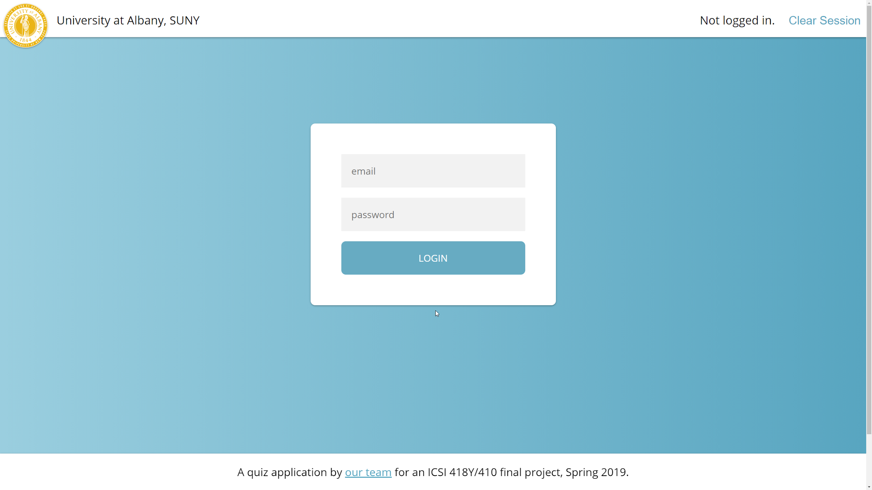
Notes:
Gary

Slide 26
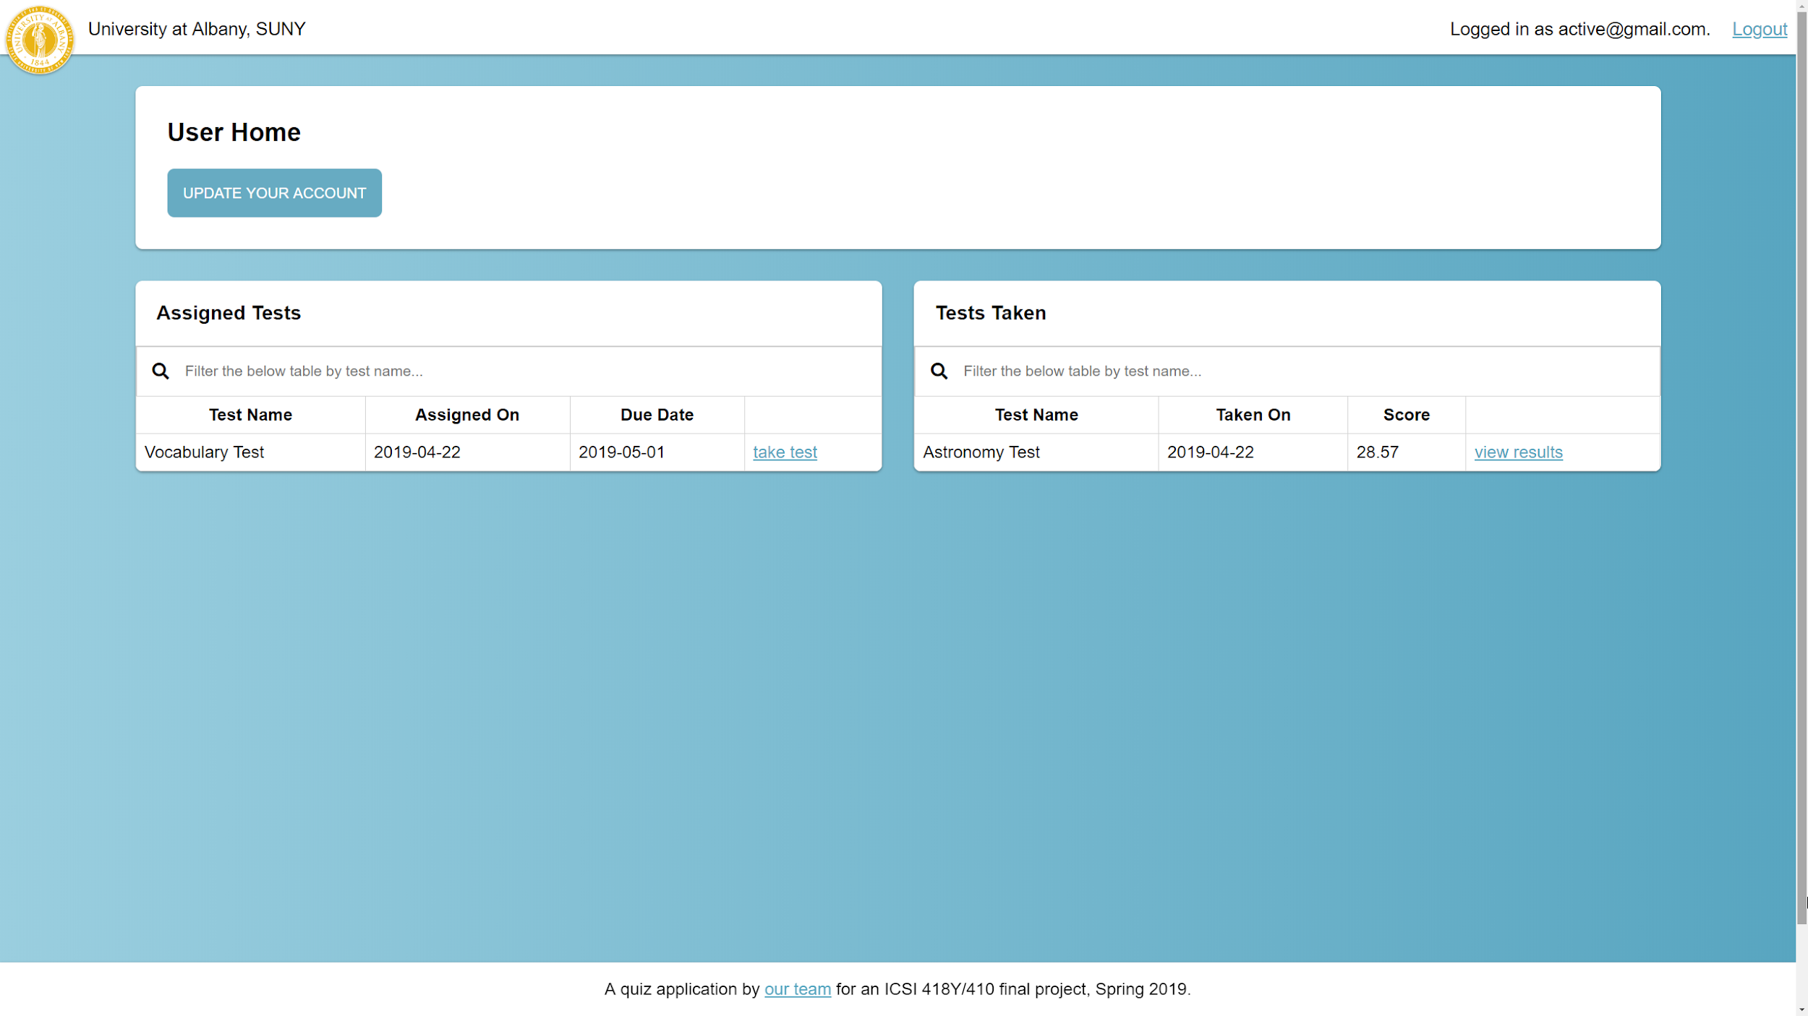
Notes:
Gary

Slide 27
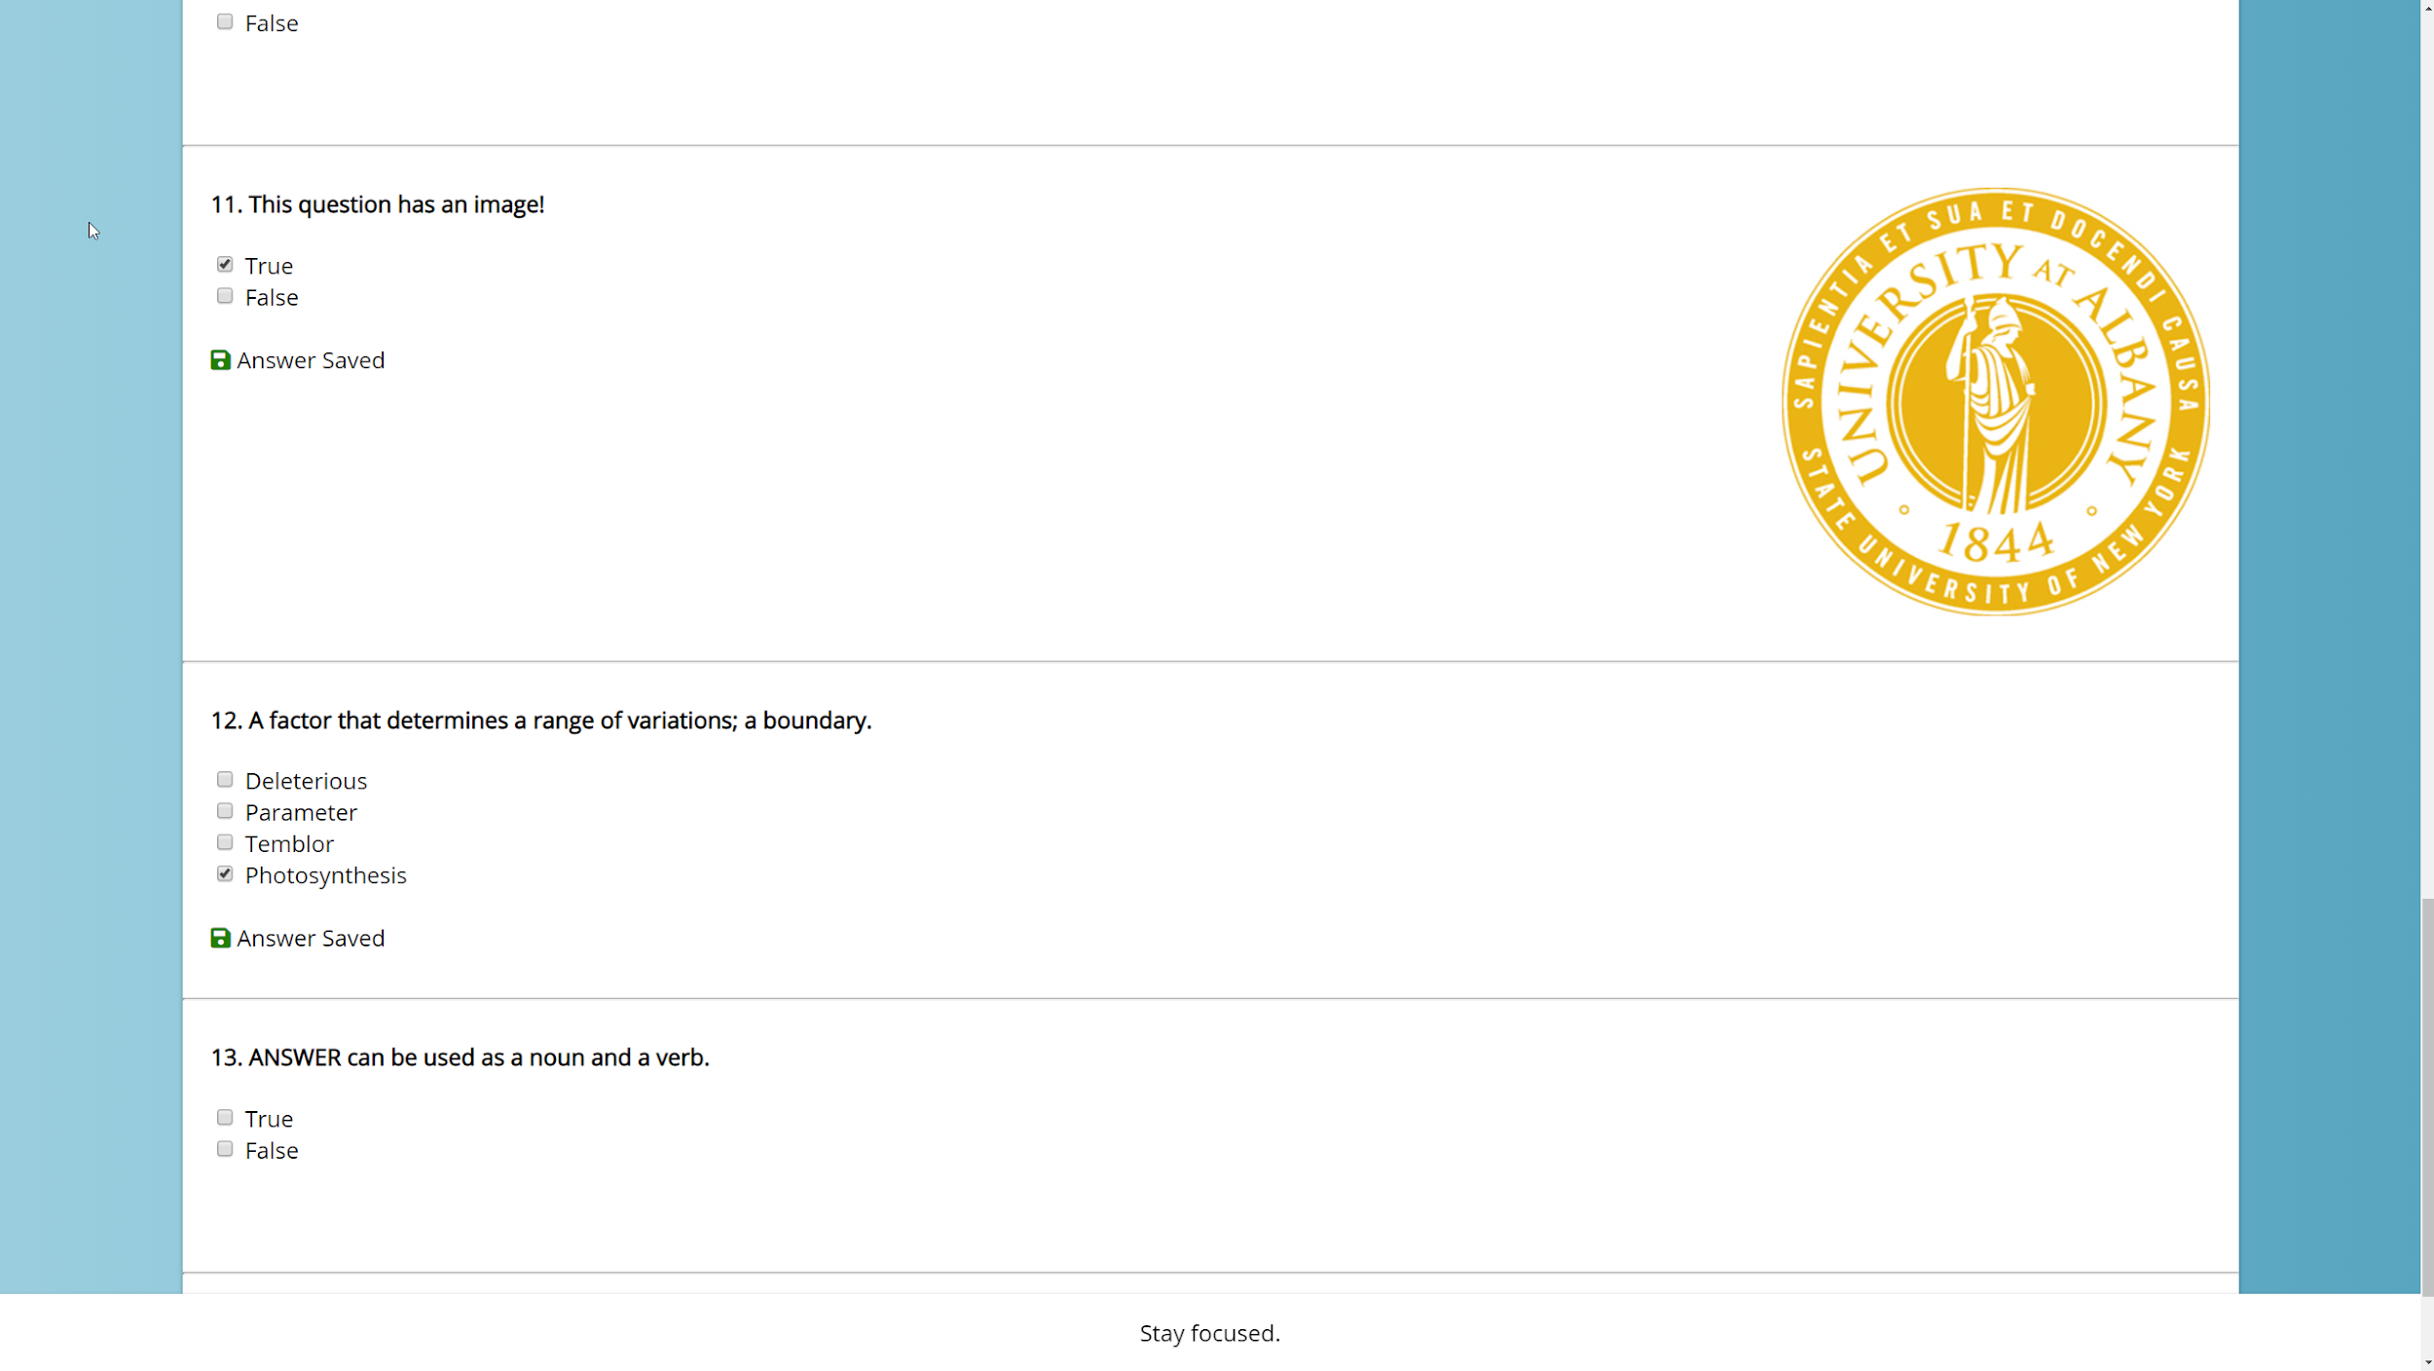
Notes:
Gary

Slide 28
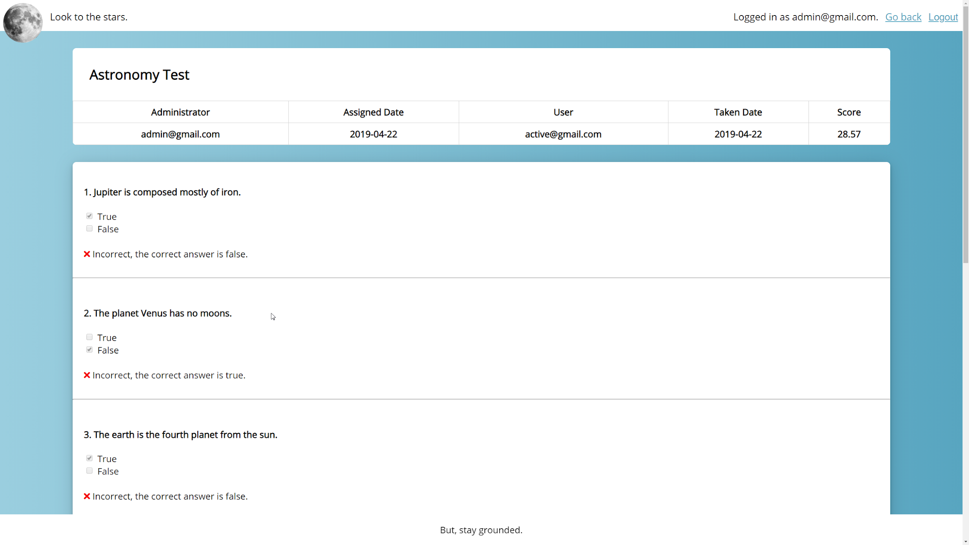
Notes:
Gary

Slide 29
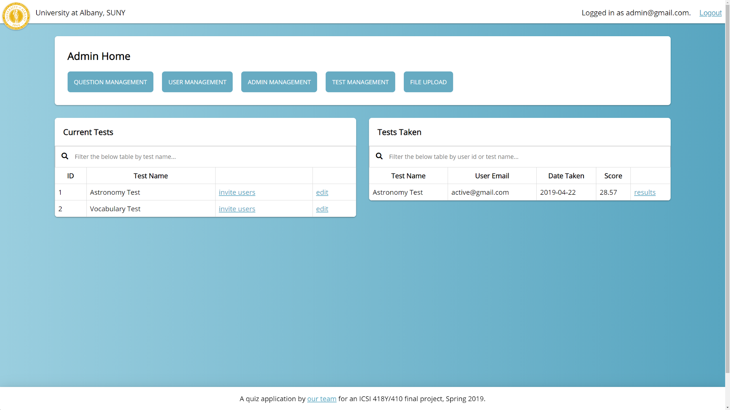
Notes:
Gary

Slide 30
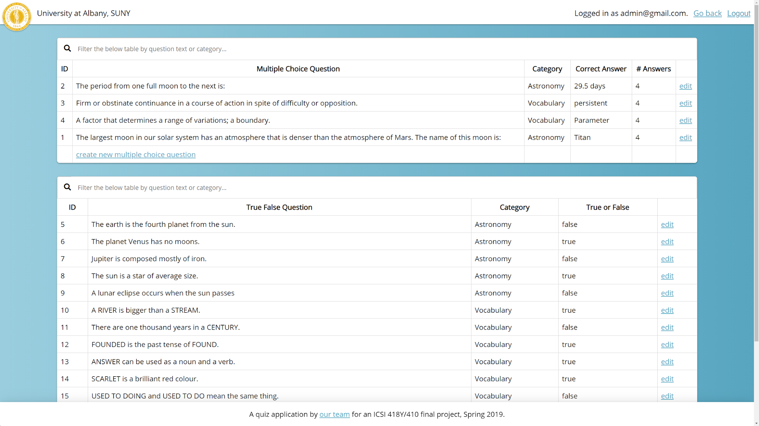
Notes:
Gary

Slide 31
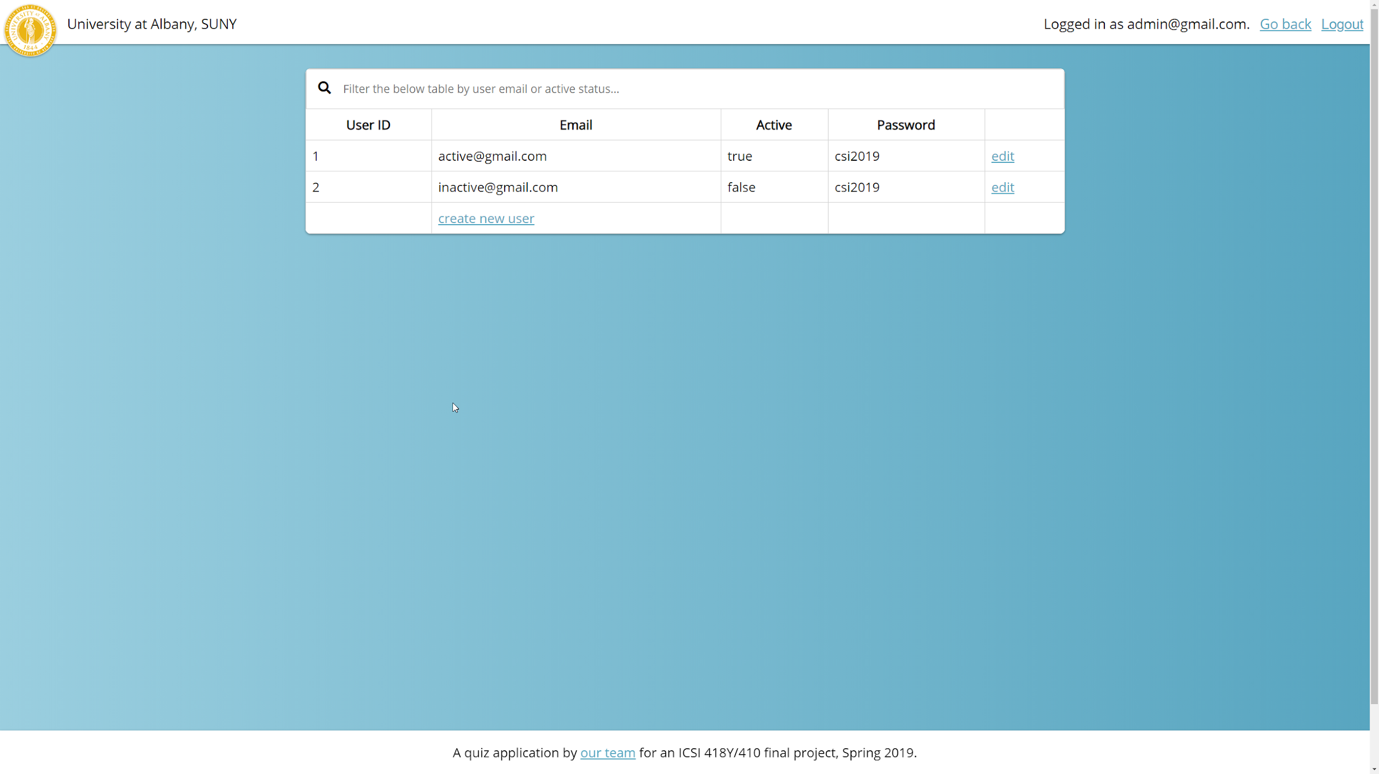
Notes:
Gary

Slide 32
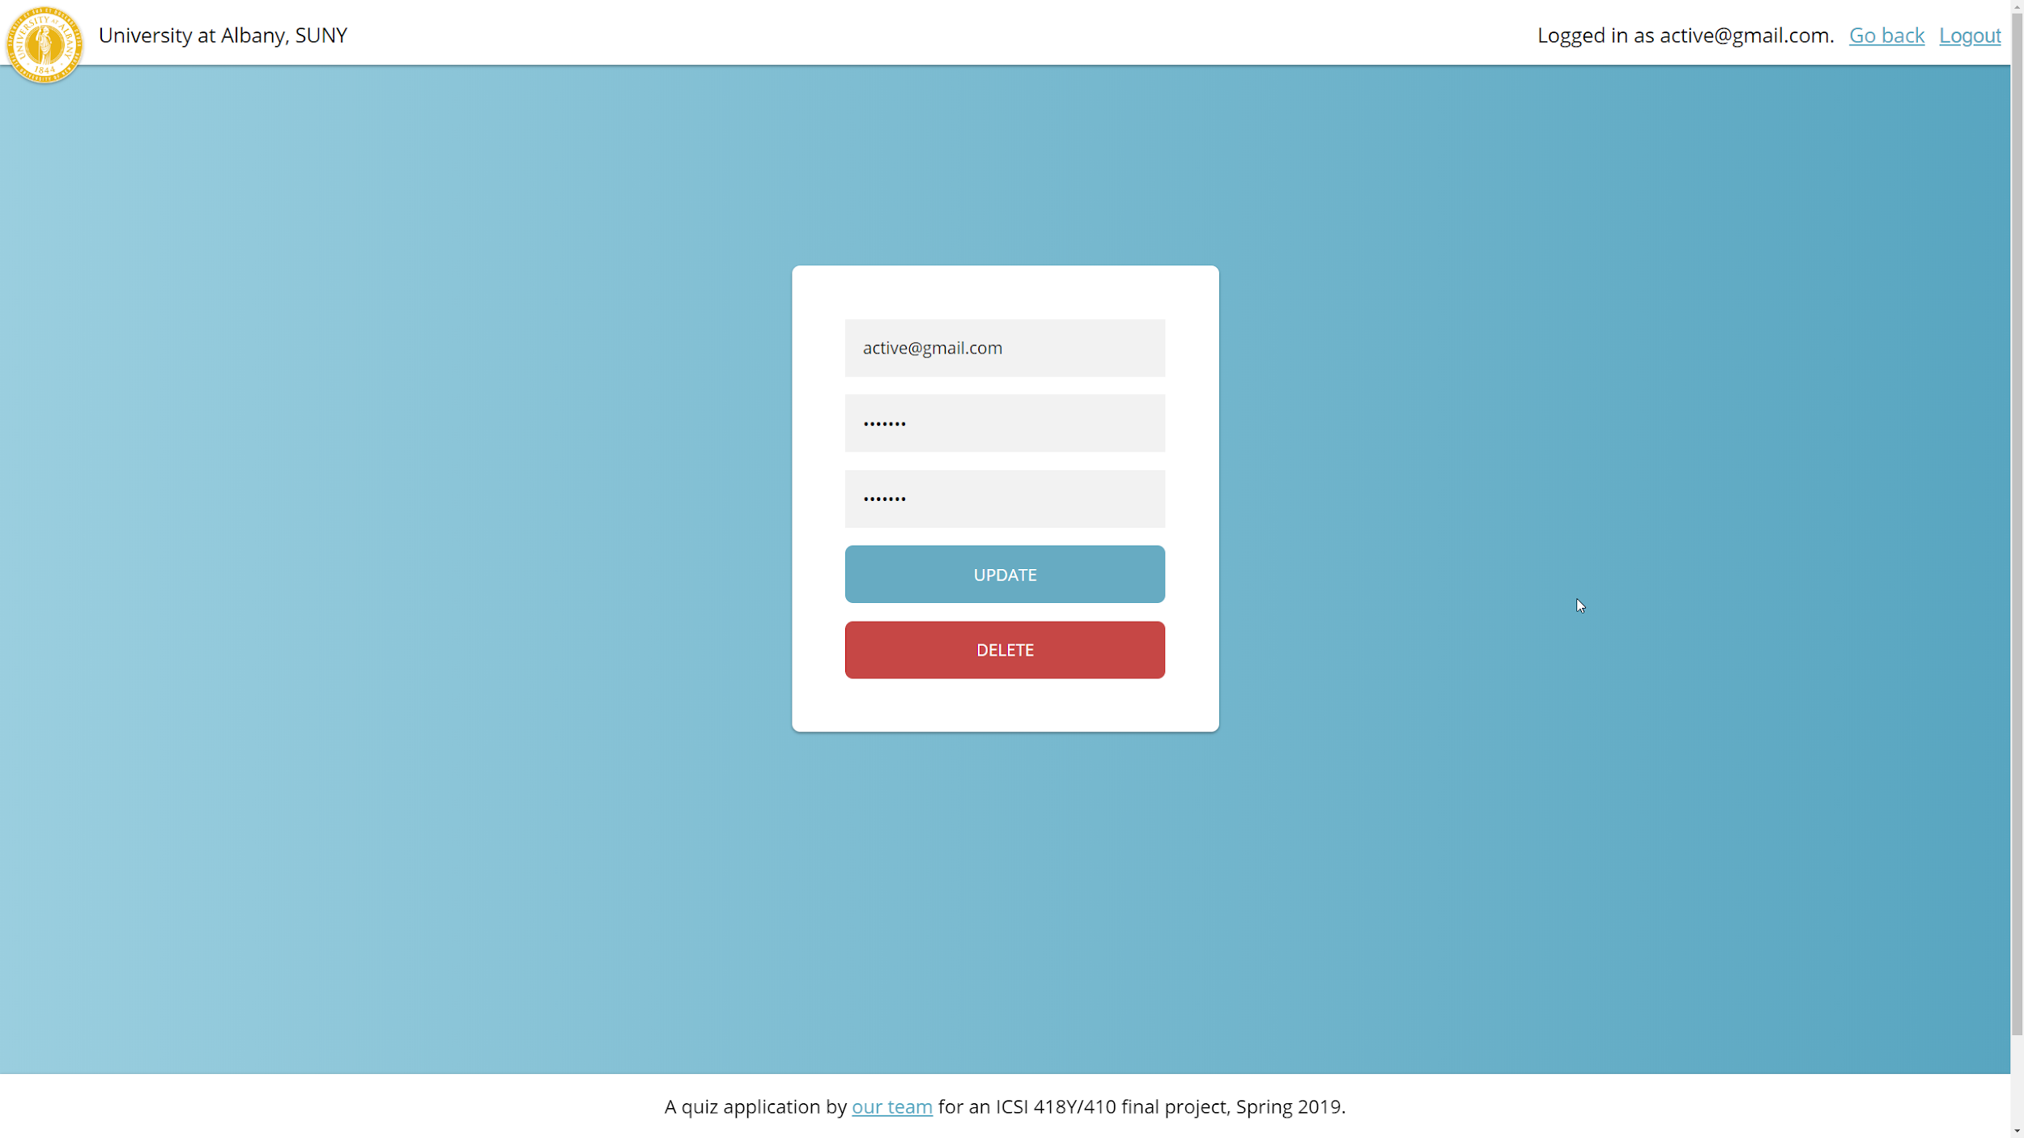
Notes:
Sean

Slide 33
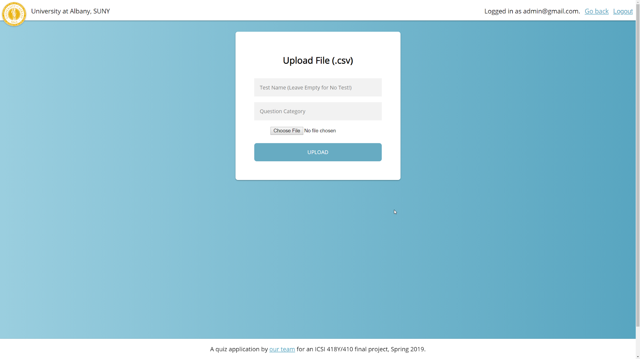
Notes:
Sean

Slide 34
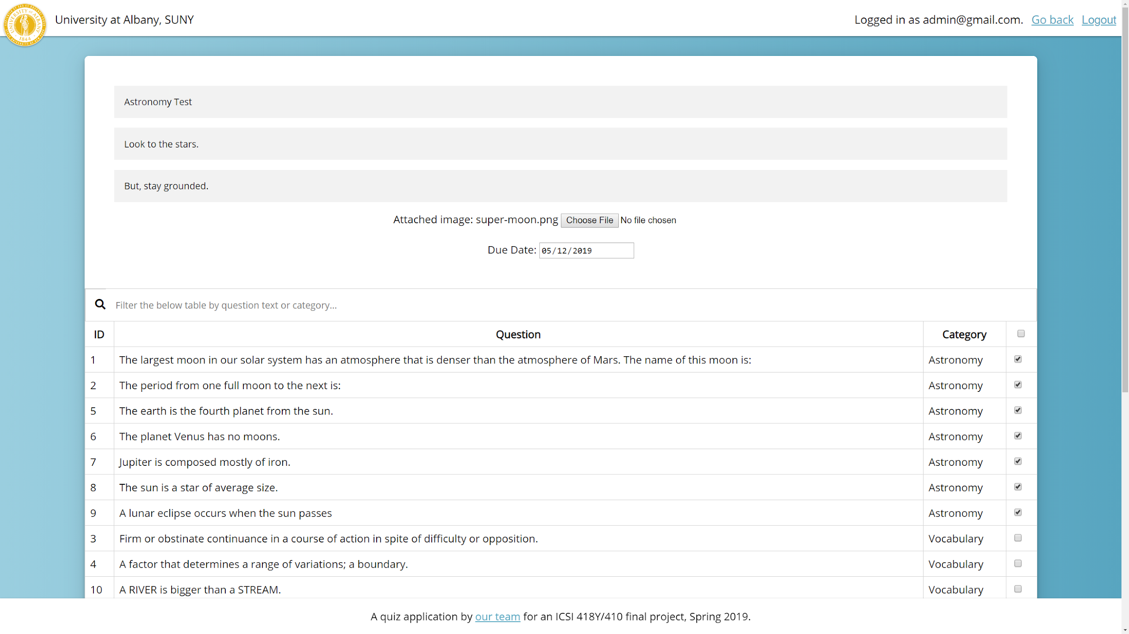
Notes:
Sean

Slide 35
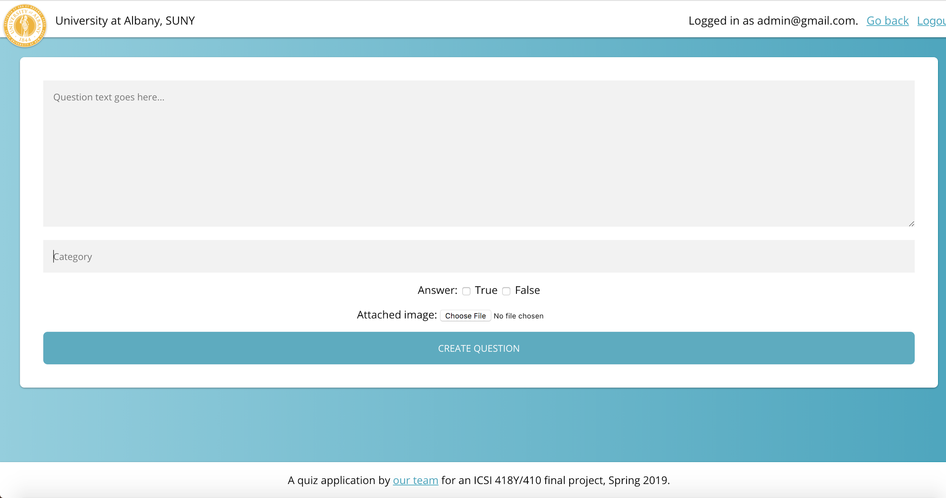
Notes:
Sean

Slide 36
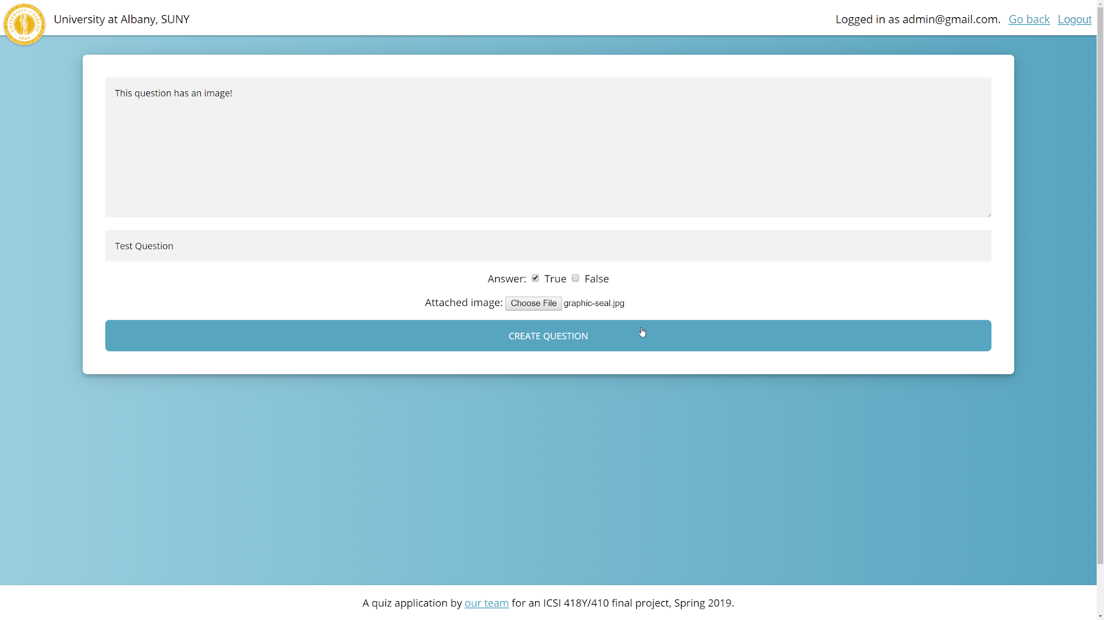
Notes:
Sean

Slide 37
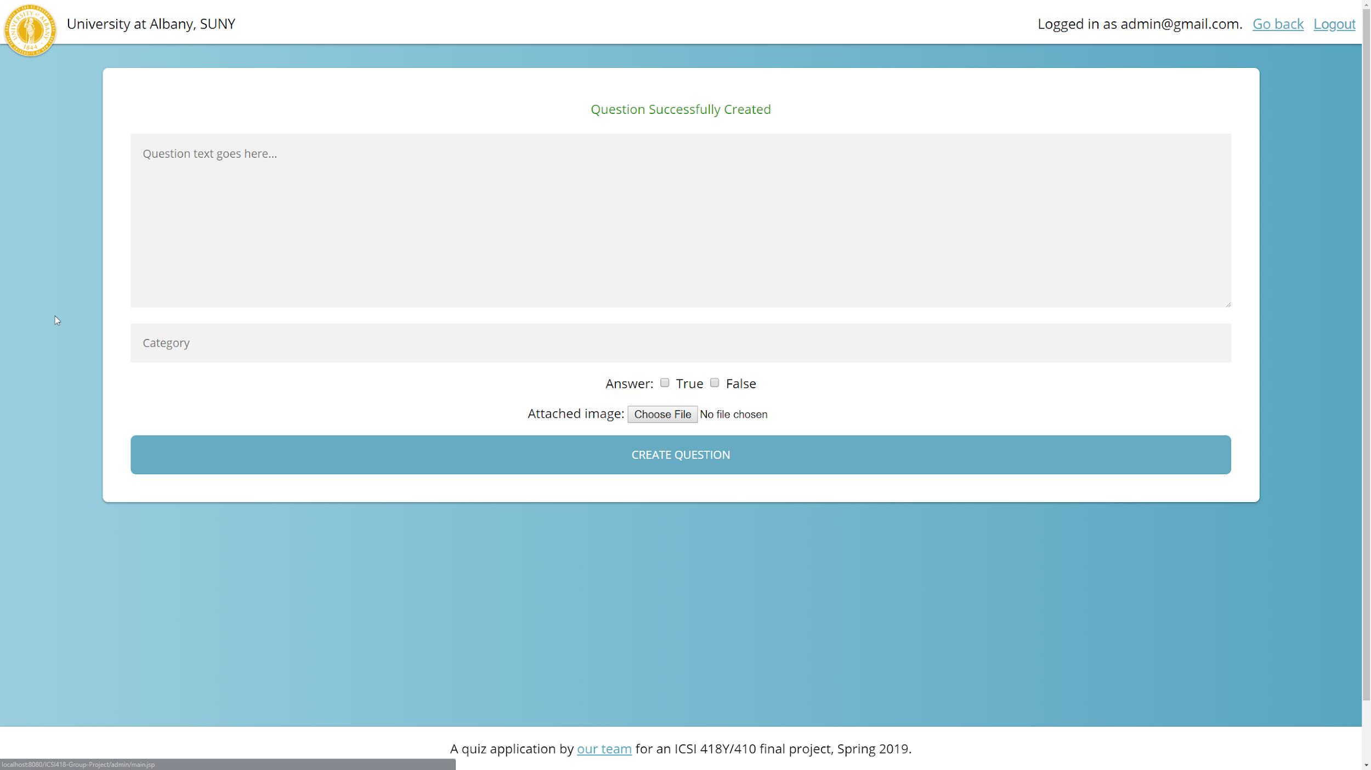
Notes:
Sean

Slide 38
Resources for this presentation:
https://www.draw.io/
https://www.lucidchart.com/
https://trello.com/
https://trello.vizydrop.com/
https://www.mysql.com/products/workbench/

Slide 39
Thank You -- questions?

